Slide 1
Quantum Computing Architectures (EE274) Lecture 6
Hiu-Yung Wong
feb. 11, 2025
hiuyung.wong@sjsu.edu, Office: ENG363
http://www.sjsu.edu/people/hiuyung.wong/index.html

Slide 2
Outline
Pauli Matrices
Density Matrix
Bloch’s Sphere
Anonymous Google Survey
Zoom + recording has been giving me a lot of trouble before.
This is an in person class. I still do not know the boundary if adding Zoom will cause some administrative issue.
I hope recording helps. And please email me if you have any questions when you watch the recording.
It will be great if the class can be delivered online via Zoom so that students at home could interact and ask questions in real-time. On test days, students need to attend in person, but on regular days, Zoom would be the best option for those with social anxiety or health concerns.

Slide 3
Pauli Matrices
Chapter 5 and Chapter 6 of “Quantum Computing Architecture and Hardware for Engineers: Step by Step”
Introduction to Quantum Computing From a Layperson to a Programmer in 30 Steps – YouTube
https://www.youtube.com/playlist?list=PLnK6MrIqGXsJfcBdppW3CKJ858zR8P4eP

Slide 4
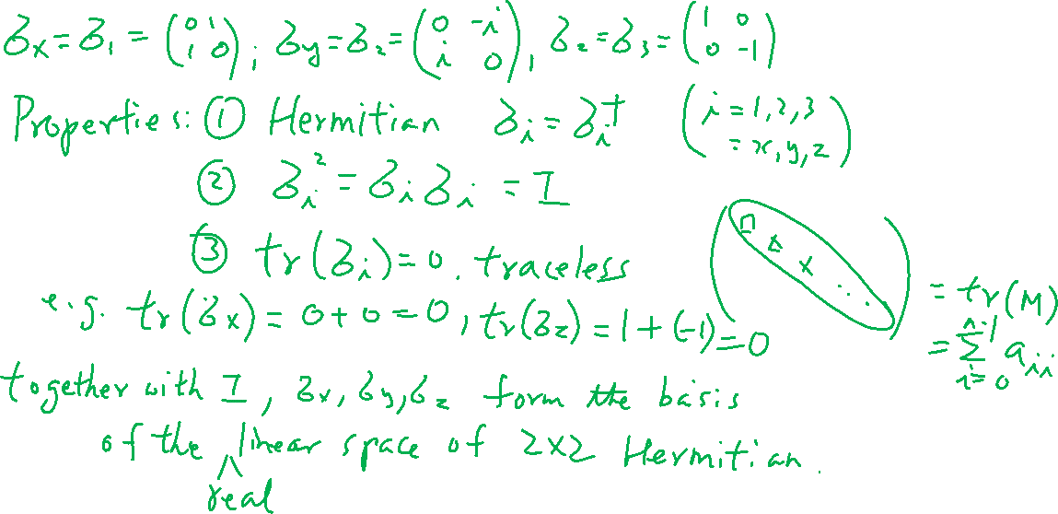
Pauli Matrices
From last lecture
Learning outcomes: Memorize the matrices and understand that with the identity matrix, they form the basis of any 2X2 matrices

Slide 5
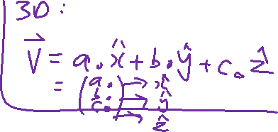
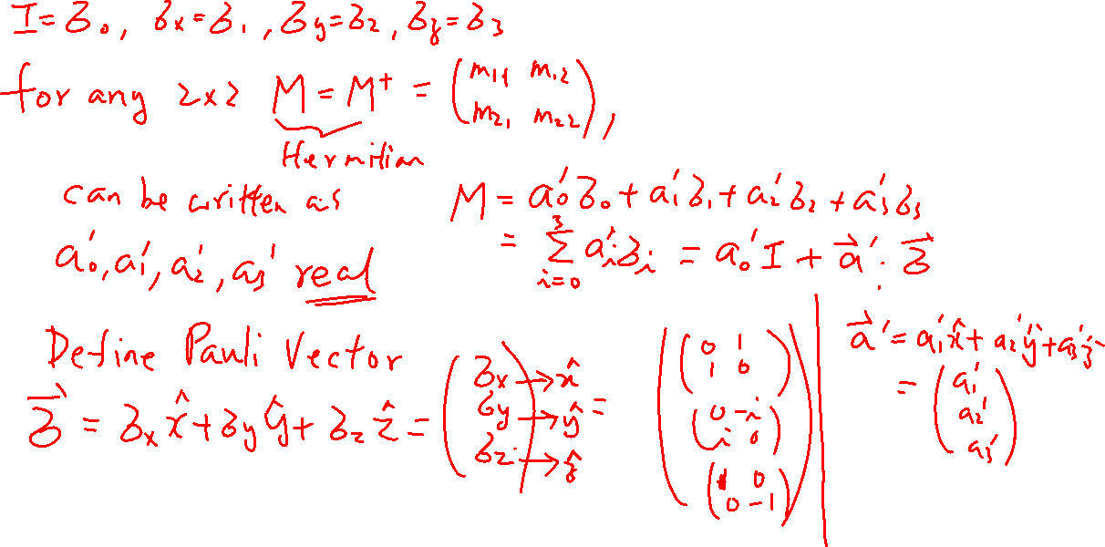
Wiki:
From last lecture

Slide 6
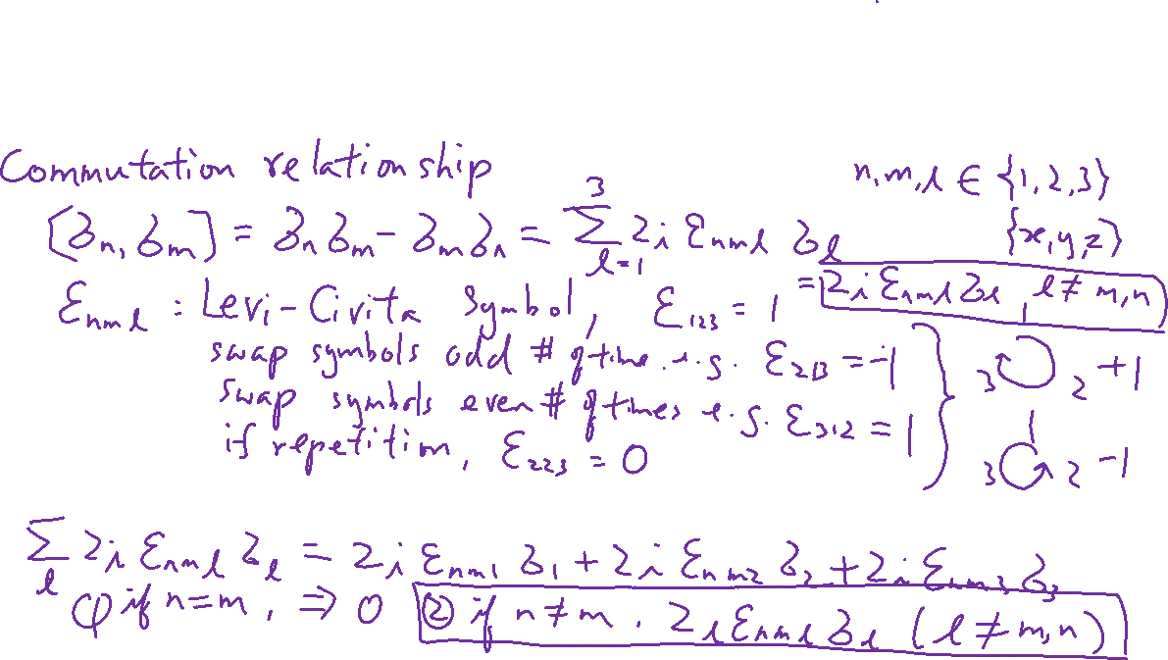
Pauli Matrices (not including I) – Commutation ad Anti-Commutation Properties
Learning outcomes: understand both properties and their meaning

Slide 7
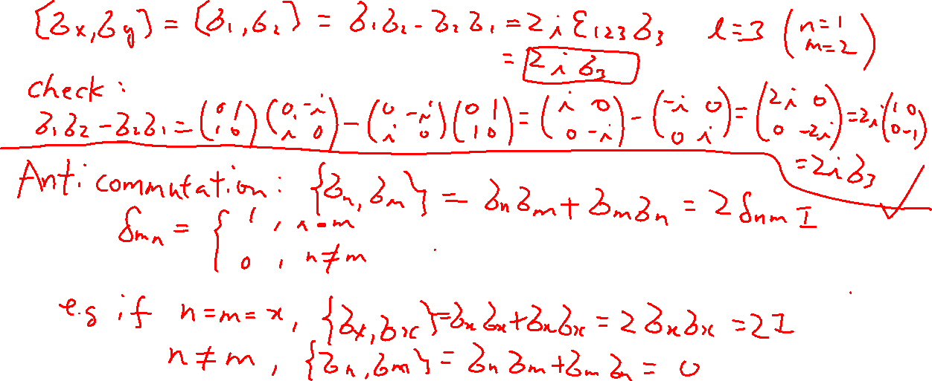
Pauli Matrices (not including I) – Commutation ad Anti-Commutation Properties
Learning outcomes: understand both properties and their meaning

Slide 8
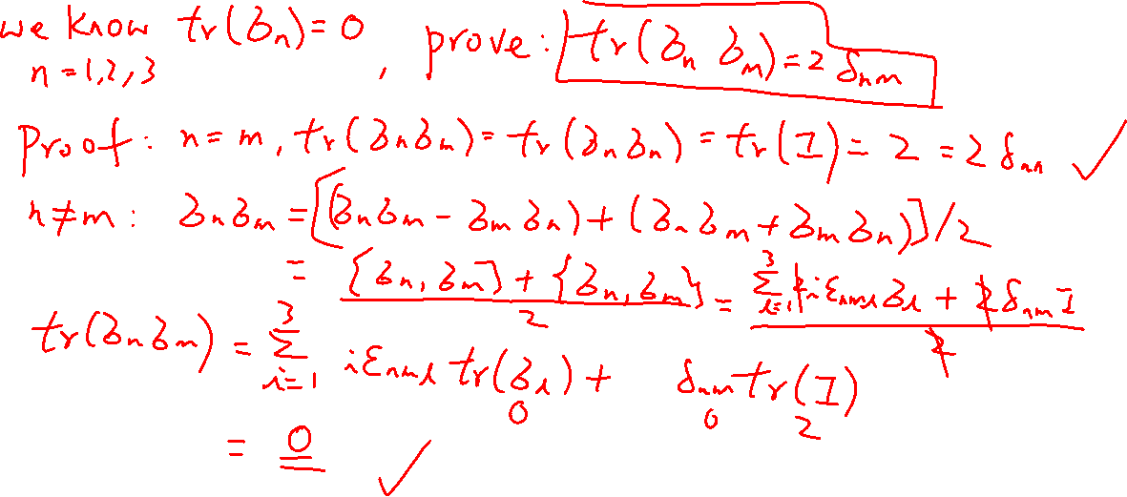
Pauli Matrices – Trace Property
Learning outcomes: The associated math skills

Slide 9
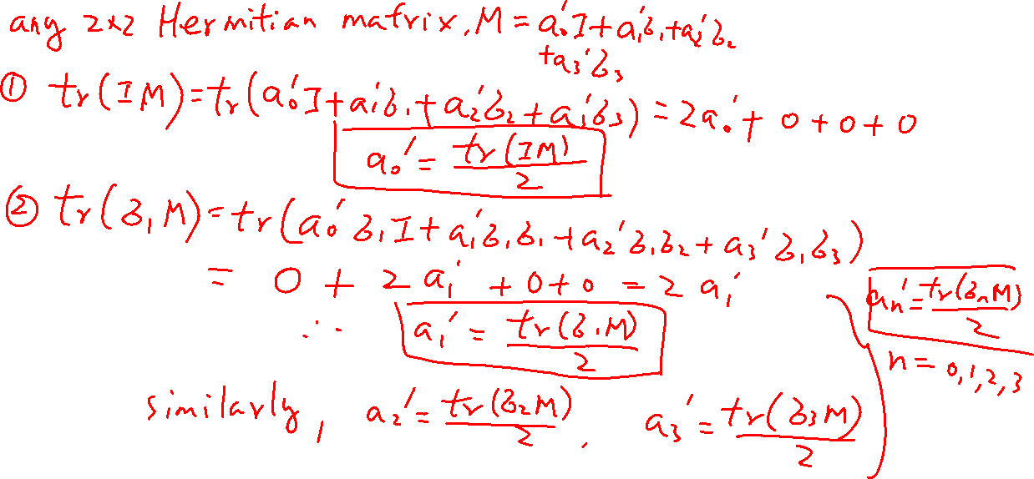
Pauli Matrices – Trace Property
Learning outcomes: The associated math skills

Slide 10
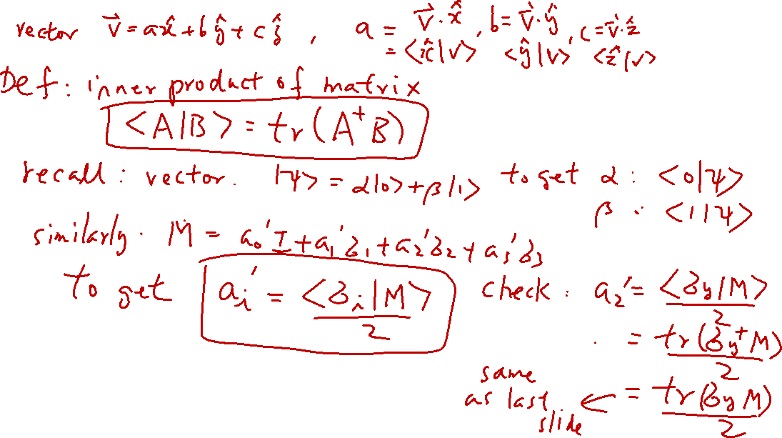
Inner Product of Matrix
Learning outcomes: Understand this is just another vector space

Slide 11
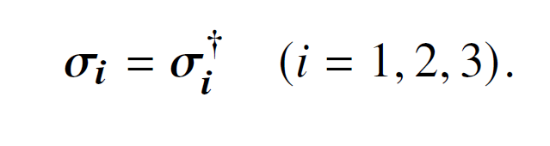
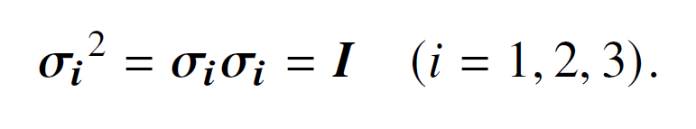
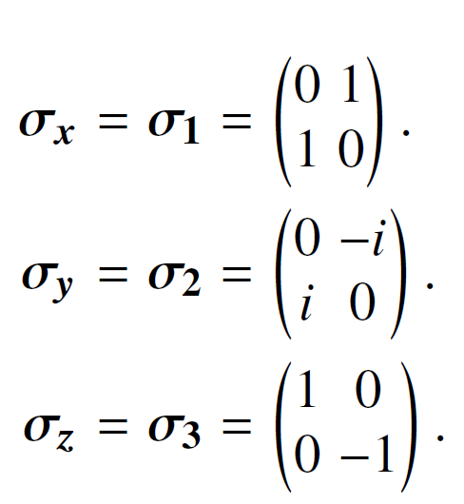

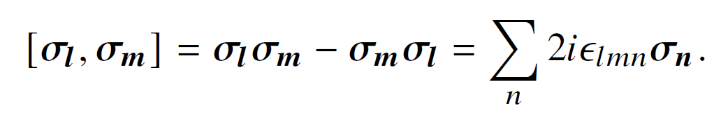
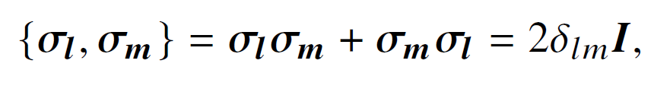

Summary
Hermitian
Pauli Matrices:
Properties
Traceless
Commutation property
Anti-Commutation property

Slide 12
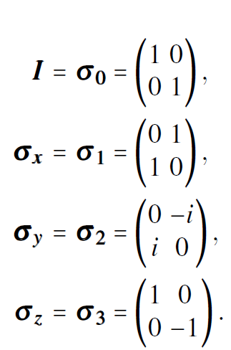

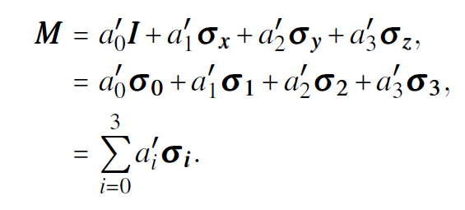
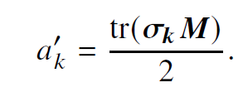
Summary
Basis of 2×2 matrix space:
Inner product of matrices:
Questions: Are the basis orthonormal?

Slide 13
Density Matrix
Chapter 6 of “Quantum Computing Architecture and Hardware for Engineers: Step by Step”
Introduction to Quantum Computing From a Layperson to a Programmer in 30 Steps – YouTube
https://www.youtube.com/playlist?list=PLnK6MrIqGXsJfcBdppW3CKJ858zR8P4eP

Slide 14
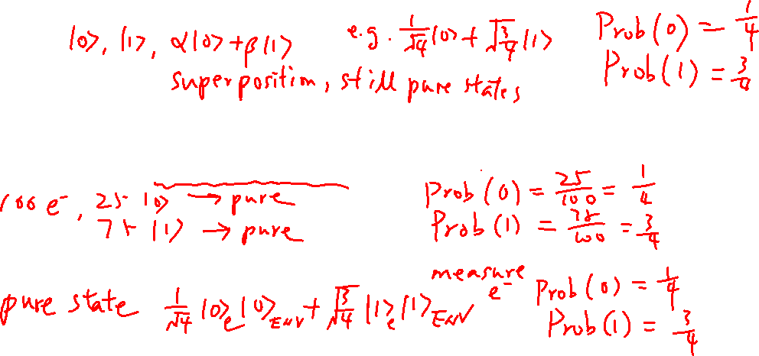
Pure States and Mixed States
Learning outcomes: Pure state can be a linear combination of the basis states
Every quantum system must be in a pure state
Can be accurately described by a wavefunction/state
But sometimes we don’t have a complete knowledge of the system (mixed states)
It is an ensemble of pure states
It interacts/entangled with the environment (an open system) and we cannot describe it as an pure state

Slide 15
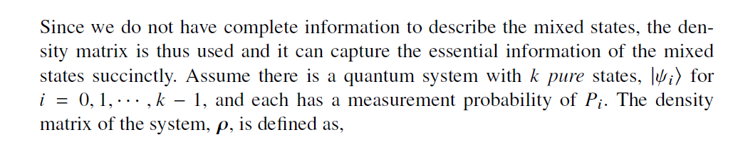
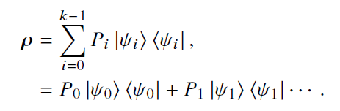
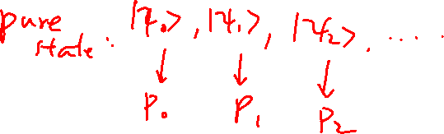
Definition of Density Matrix
Learning outcomes: Definition of density matrix

Slide 16
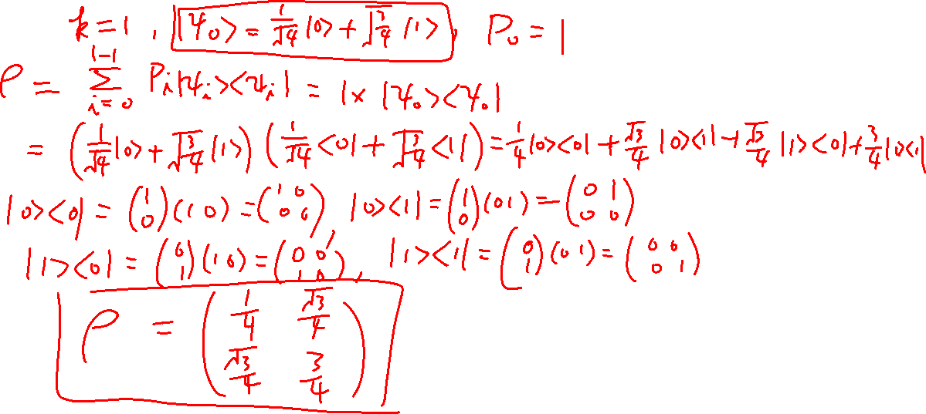
Density Matrix of Pure State
Learning outcomes: Definition of density matrix

